Slide 1

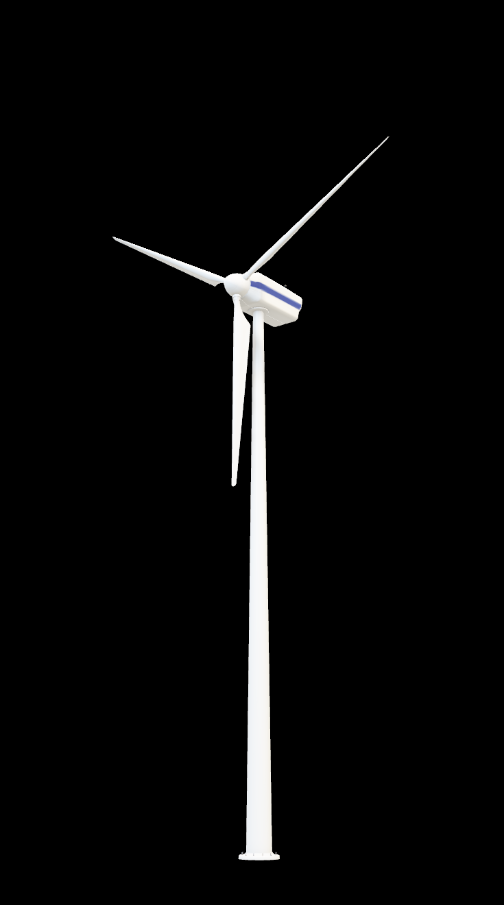
Wind Energy
Due Diligence Assessment of a Floating Offshore Wind Farm
off the Eastern Coast of Sicily
Alex Cogo
Elisa Di Lillo
Mattia Galesi
Francesco Goldaniga
Alice Grieco
Davide Gusmeroli
2025-2026
Politecnico di Milano

Slide 2

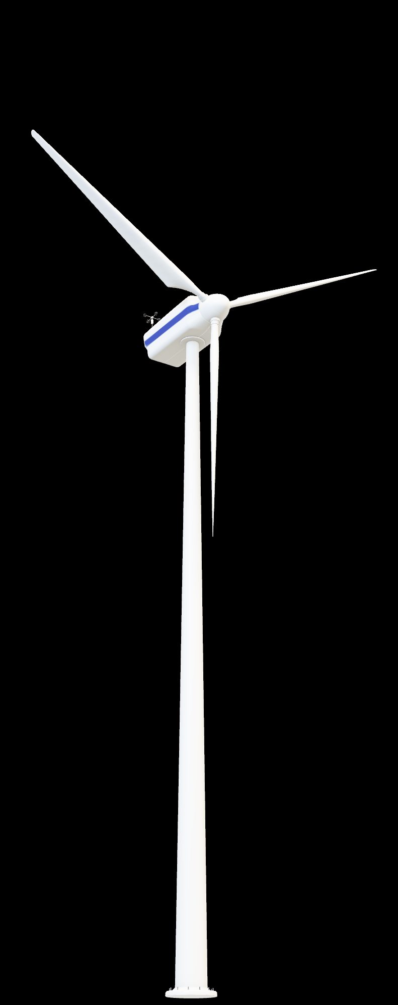
Wind Energy
Project Overview
Location
36 km off the coast
Capacity
15 MW x 33 turbines
Project status
Permitting phase
Politecnico di Milano
Notes:
Our wind farm is located 36 kilometers off the coast of Sicily and Calabria. The layout consists of 33 turbines, each with a nominal capacity of 15 MW. This gives the project a total potential capacity of 495 MW. Currently, the farm is in the permitting phase.

Slide 3



Wind Energy
Wind Energy
Turbine Technology
Floating Offshore Wind Turbines (FOWT) using Vestas V236-15 MW turbines.
Grid Connection to Shore
Landfall south of Catania; link to Terna's SE Pantano 380 substation.
Electric off-shore layout
66 kV inter-array cables, dynamic subsea cables, HV switchgear, 380 kV export via FOS.
Politecnico di Milano

Slide 4
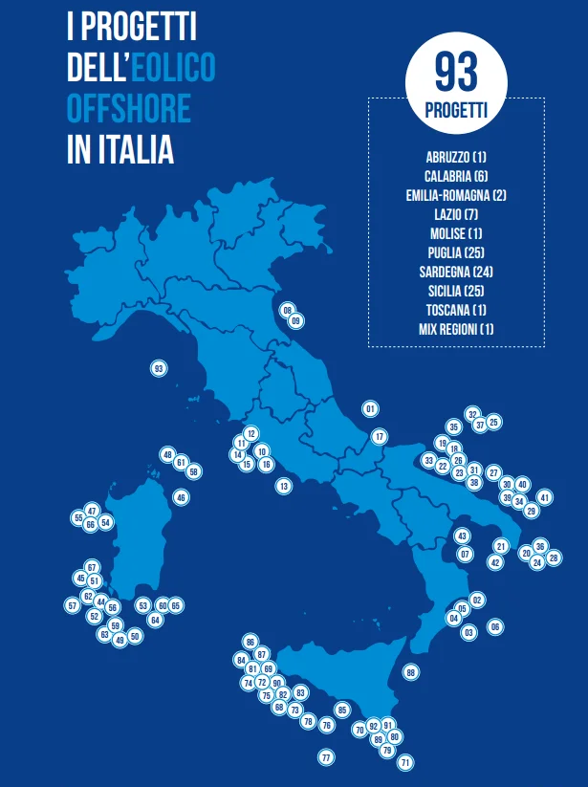
Wind Energy
Market Analysis
Italy’s strategic momentum in floating offshore wind
Global Standing
Italy ranks 3rd worldwide for floating offshore wind potential (207.3 GW).
Current Gap
Only 30 MW installed versus >70 GW under evaluation.
Strategic Advantages
8000 km coastline, major ports, shipyards, skilled maritime sector.
Investment Outlook
Updated incentives and supply-chain consolidation support rapid growth.
Sicily as a Hub
Strong winds, deep waters, ideal for floating foundations.
Politecnico di Milano
Notes:
The market analysis highlights Italy's strategy. Italy ranks 3rd worldwide for floating offshore wind potential, with a theoretical capacity of 207.3 GW. Currently, there is a significant gap: only 30 MW are installed, while over 70 GW are under evaluation.
Our country benefits from strategic advantages, including 8,000 km of coastline characterized by deep waters and strong winds—ideal conditions for floating turbines, particularly in Sicily. From an economic perspective, the supply chain is consolidating, and incentives are growing, such as those provided by the FER2 Decree.

Slide 5
Wind Energy
Regulatory Framework
The development of a 495 MW floating offshore wind farm requires compliance with a wide regulatory framework:
PNRR (National Recovery and Resilience Plan)
PNIEC (Integrated National Energy and Climate Plan)
FER2 DECREE : Ensures bankability (25-year incentives).
Legislative Decree No. 190/2024, Article 9, Annex C: our field is > 300 MW, so its authorization is managed by MASE.
Grid connection: Connection to Terna "SE Pantano 380" substation.
Sustainability: No interference with Natura 2000 or fisheries.
Politecnico di Milano
Notes:
Our project fits perfectly with the PNRR and PNIEC frameworks. We ensure bankability through the FER2 Decree's 25-year incentives. Because our capacity is over 300 MW, MASE handles our authorization directly. Crucially, the site avoids all Natura 2000 areas and local fishing zones.

Slide 6




Wind Energy
Environmental Impact
Impact on air quality
Impact on biodiversity
Construction emissions are limited and mitigated, while turbine operation avoids large quantities of fossil fuel emissions, resulting in a net positive effect.
Temporary, reversible effects may occur during construction; operational phases promote new habitats via turbine foundations.
Acoustic impact
Landscape impact
Construction noise is short term and mitigated. Operational noise remains low and non-critical for fauna.
At 35-45 km from the coast, turbines are barely visible. Landscape impacts are negligible.
Politecnico di Milano
Notes:
Moving on to the Environmental Impact, we have analyzed four key areas.
Regarding Air Quality, while construction emissions are temporary, the long-term operation avoids fossil fuels, resulting in a net positive effect.
For Biodiversity and Acoustics, impacts are primarily limited to the construction phase and there are a lot of systems to mitigate them.
Finally, the Visual Impact is negligible because the farm is located 36 km from the coast, making the turbines barely visible.
I will now let ……. continue

Slide 7
Wind Energy
Operational Performance Assessment
Methodological Approaches
Weibull-Based Method
A statistical fitting of the Weibull distribution to the wind-speed datasets, providing a probabilistic representation of wind variability at turbine locations.
Markovian Probability
A direct statistical approach using gridded wind datasets to predict wind speeds at each turbine coordinate.
Wind Datasets Used
NEWA-New European Wind Atlas
API-based mean wind speed and power density extracted for all 33 turbine coordinates.
Aeolian-Italian Wind Atlas
Grid-based wind-speed and power-density dataset processed via Python extraction script.
Politecnico di Milano

Slide 8
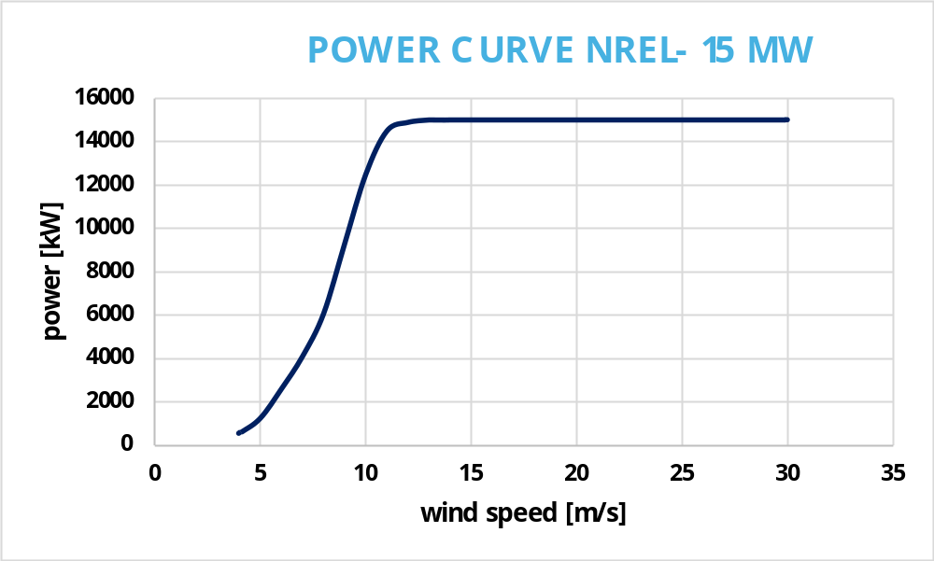
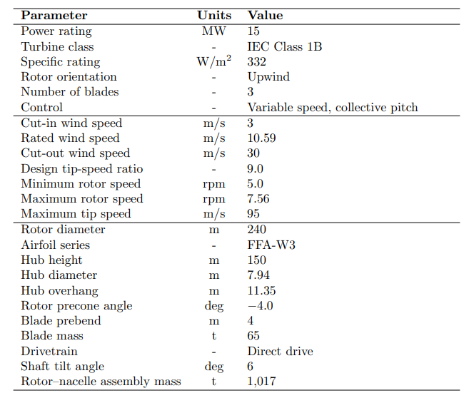
Wind Energy
Power curve and technical specifications
Politecnico di Milano

Slide 9
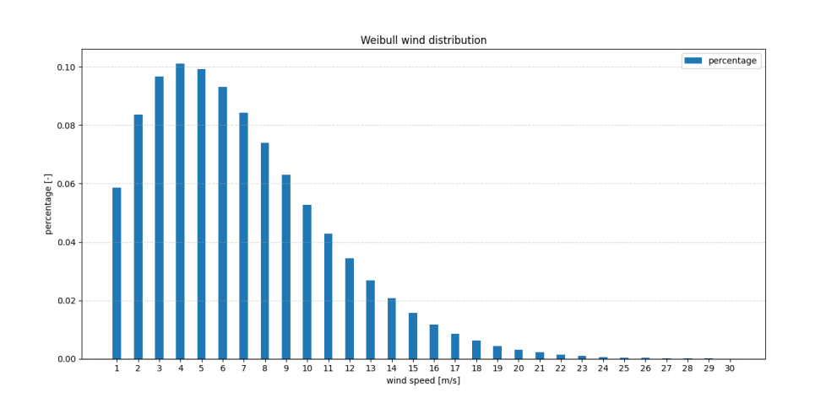
Wind Energy
Weibull distribution
The Weibull model was used to estimate wind-speed probabilities, providing the statistical distribution used for energy production assessment.
Politecnico di Milano

Slide 10
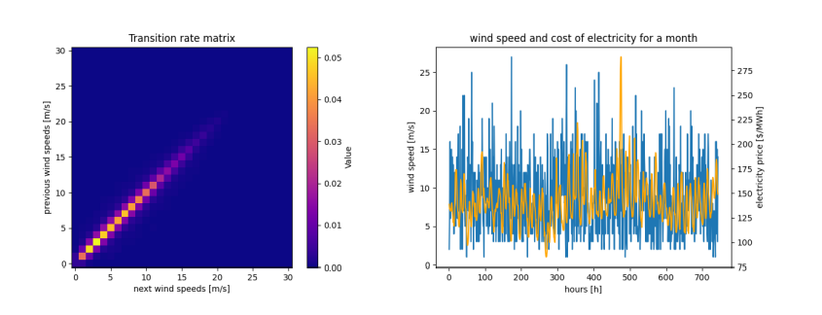
Wind Energy
Markovian probability
A Markov transition matrix was used to model how wind speed evolves over time, capturing its temporal variability for more realistic simulations.
Politecnico di Milano

Slide 11
Wind Energy
Correction factors
To obtain realistic energy production estimates, several correction factors were applied to account for physical conditions, technical losses, and turbine availability:
Air Density Correction
Real air density was calculated using site-specific temperature and pressure data at 150 m. The ratio between real and ideal air density was applied as a correction factor.
Generation, Mechanical & Electrical Losses
Standard correction factors from the literature were applied to account for generator efficiency, drivetrain losses, and electrical transmission losses.
Turbine Availability
An availability factor was included to reflect planned maintenance and unplanned outages. A reliability coefficient was used to estimate effective operational availability.
Monthly Wind Speed & Power-Density Adjustments
A shear-correction factor and monthly power-density multipliers were applied to better match the vertical wind profile and long-term mean conditions.
Politecnico di Milano

Slide 12
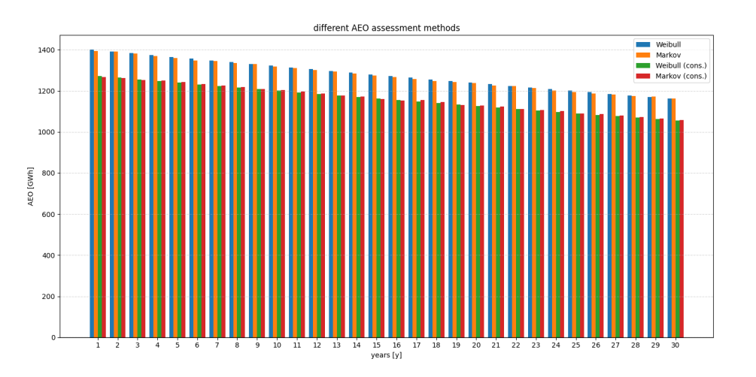
Wind Energy
Results
Annual energy production remains consistently high across all methods, with the wind farm still exceeding 1000 GWh/year even after 30 years despite gradual turbine degradation.
Equivalent hours
2811 h
Capacity factor
32.1%
Politecnico di Milano

Slide 13


Wind Energy
Economic Feasibility Assessment
Is the project economically feasible?
BENCHMARK SCENARIO
UPGRADE SCENARIO
UP. HOURLY SCENARIO
HYDROGEN SCENARIO
SENSITIVITY ANALYSIS
NO FIP SCENARIOS
Politecnico di Milano

Slide 14
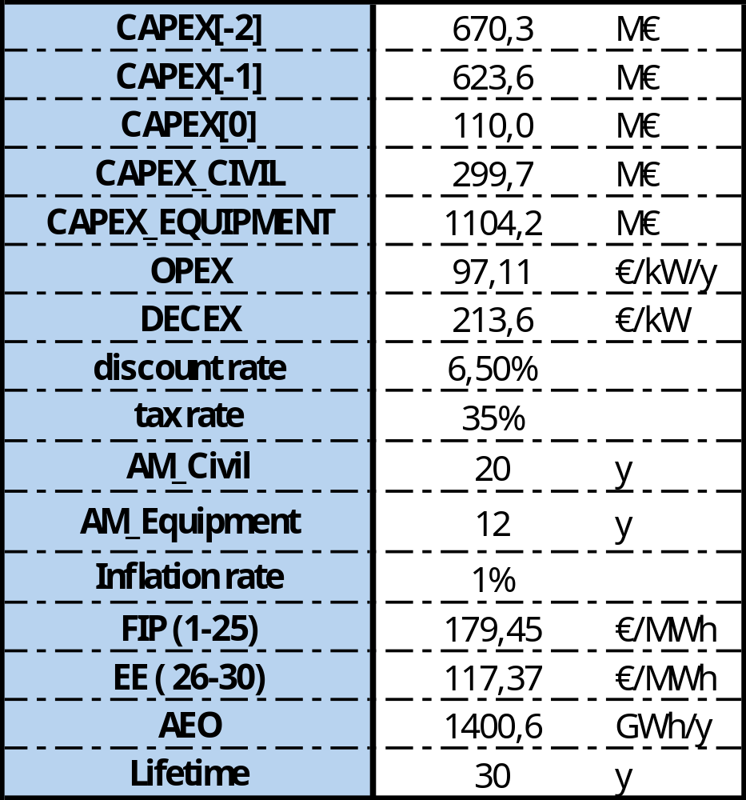
Wind Energy
BENCHMARK SCENARIO
UPGRADE SCENARIO
UP. HOURLY SCENARIO
Benchmark Scenario: Data
From project documentation
Assumptions:
All data are constant across different years.
Decex are equally splitted at years 31 and 32.
Averages from literature
For first 25 years
From year 26 on
Politecnico di Milano

Slide 15
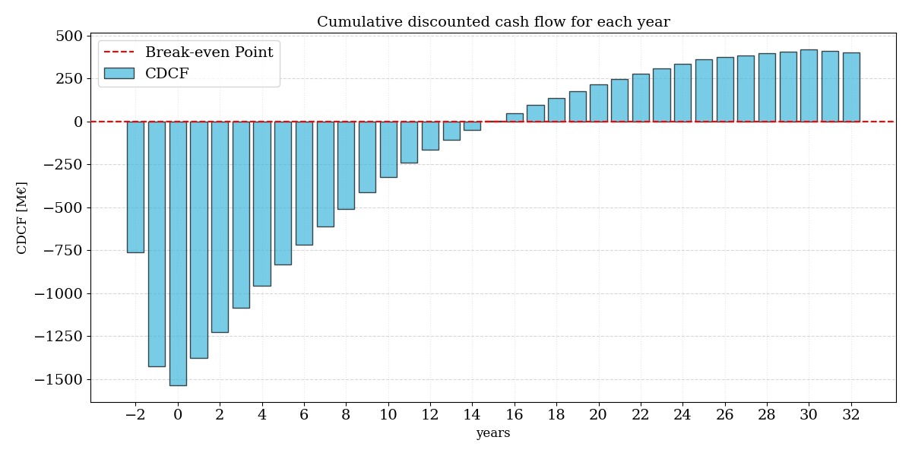
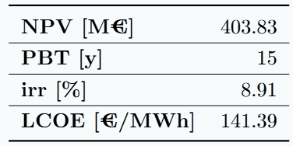


Wind Energy
BENCHMARK SCENARIO
UPGRADE SCENARIO
UP. HOURLY SCENARIO
Benchmark Scenario: Results
Very profitable investment!
LCOE is higher than DAM electricity price
Politecnico di Milano

Slide 16
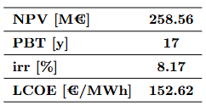
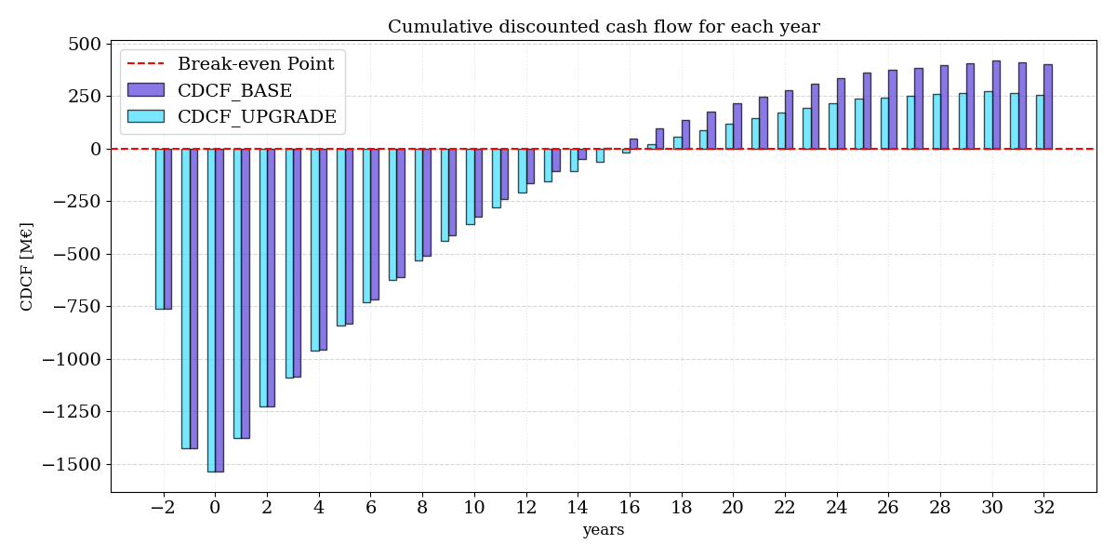
Wind Energy
BENCHMARK SCENARIO
UPGRADE SCENARIO
UP. HOURLY SCENARIO
Upgrade Scenario
AEO reduction due to turbines degradation over time.
OPEX increase due to higher failure rates with years of operation.
Still positive NPV but lower than benchmark
Higher Pay Back Time
Politecnico di Milano

Slide 17
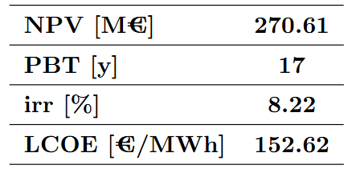
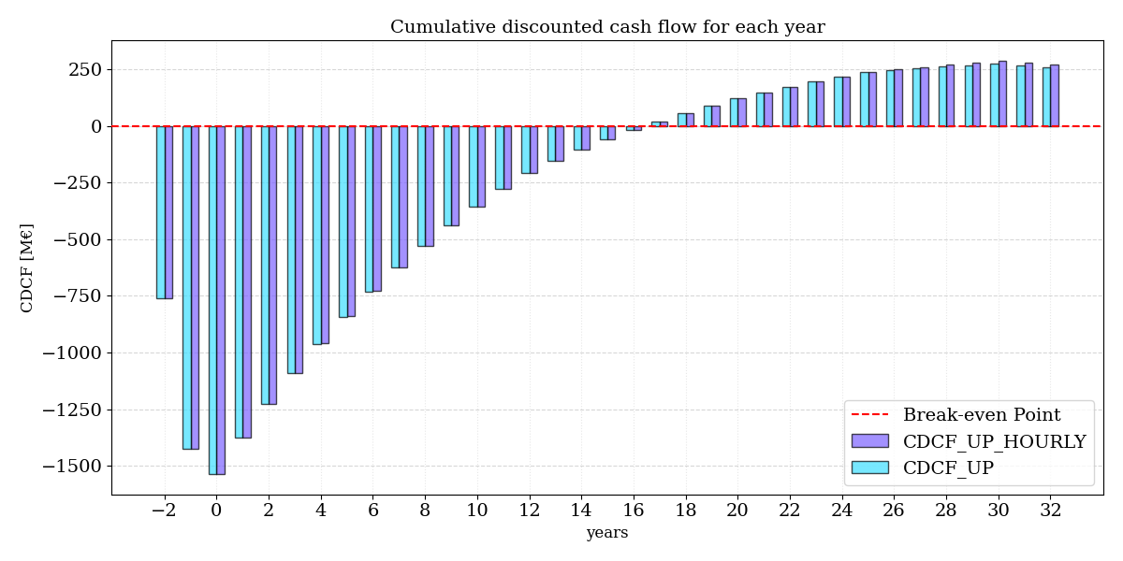
Wind Energy
BENCHMARK SCENARIO
UPGRADE SCENARIO
UP. HOURLY SCENARIO
Upgrade Hourly Scenario
Hourly electricity selling price is accounted for the last 5 years!
Hourly wind energy production is accounted!
Very similar results to the Upgrade scenario!
Politecnico di Milano

Slide 18
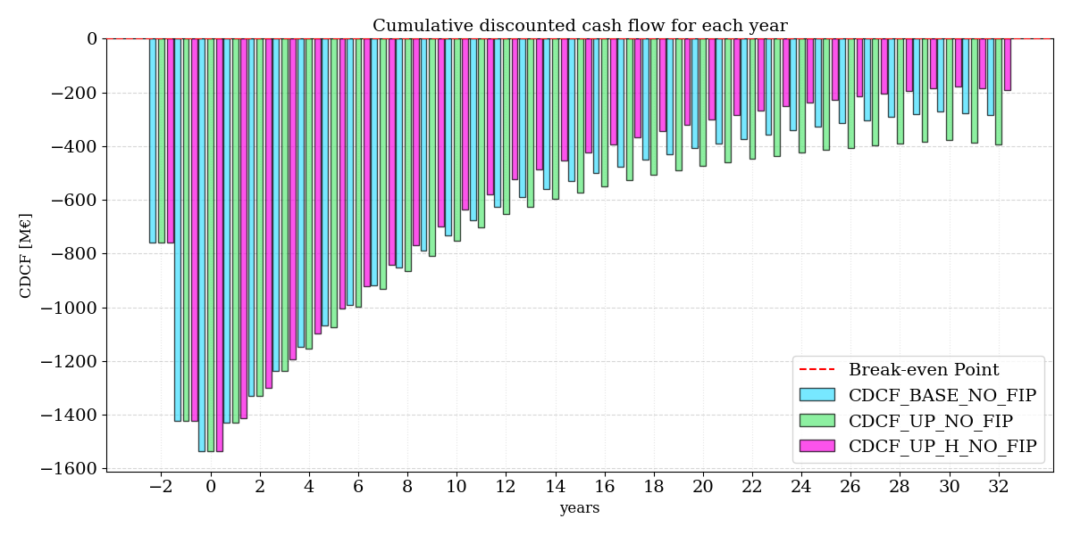

Wind Energy
HYDROGEN SCENARIO
SENSITIVITY ANALYSIS
NO FIP SCENARIOS
What if FIP is lost?
LCOE > Electricity Selling Price
NPV < 0
Politecnico di Milano

Slide 19
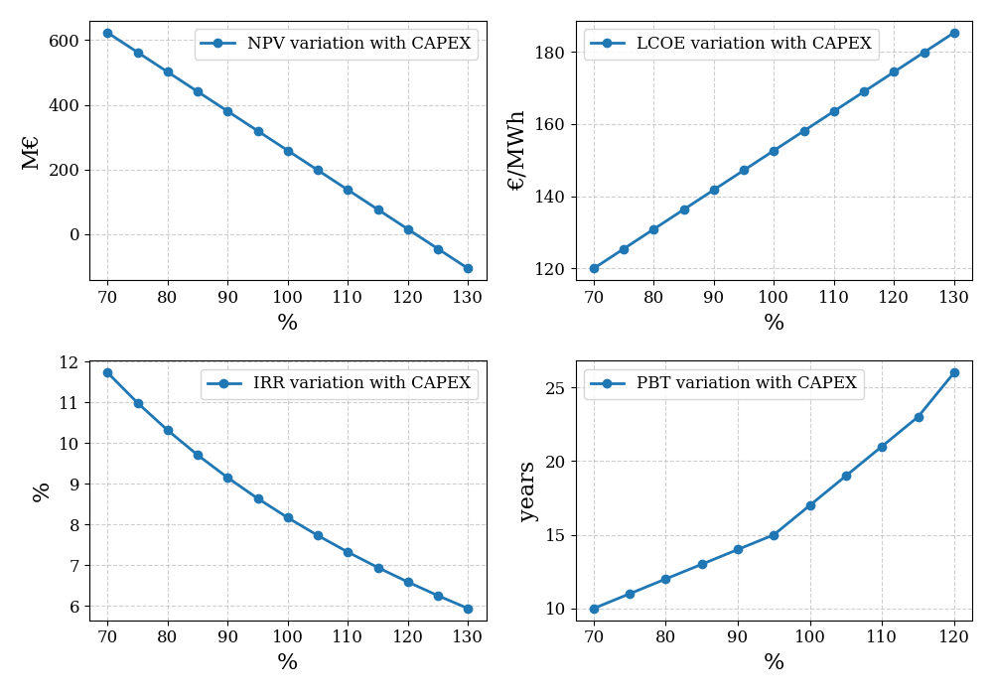
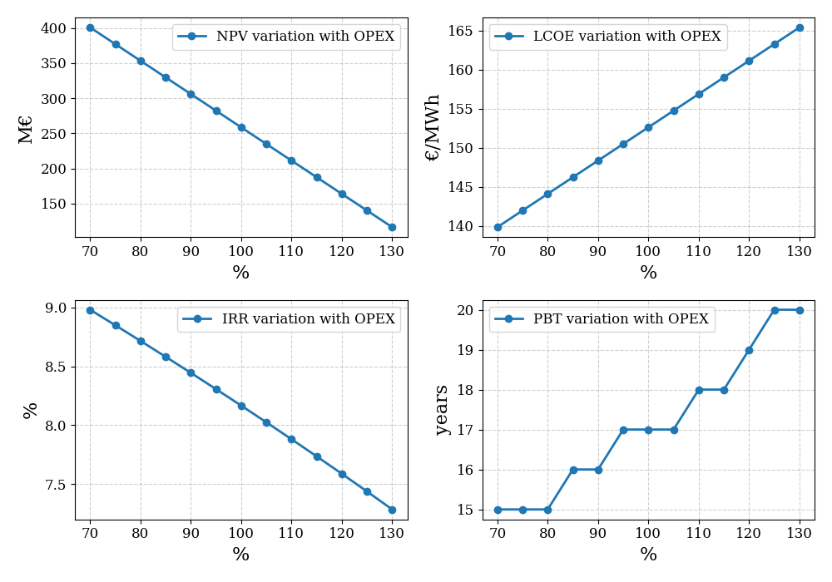
Wind Energy
HYDROGEN SCENARIO
SENSITIVITY ANALYSIS
NO FIP SCENARIOS
Sensitivity Analysis
Performed with respect to Upgrade Scenario.
Range of variation from 0,7 to 1,3 of nominal values.
Politecnico di Milano

Slide 20
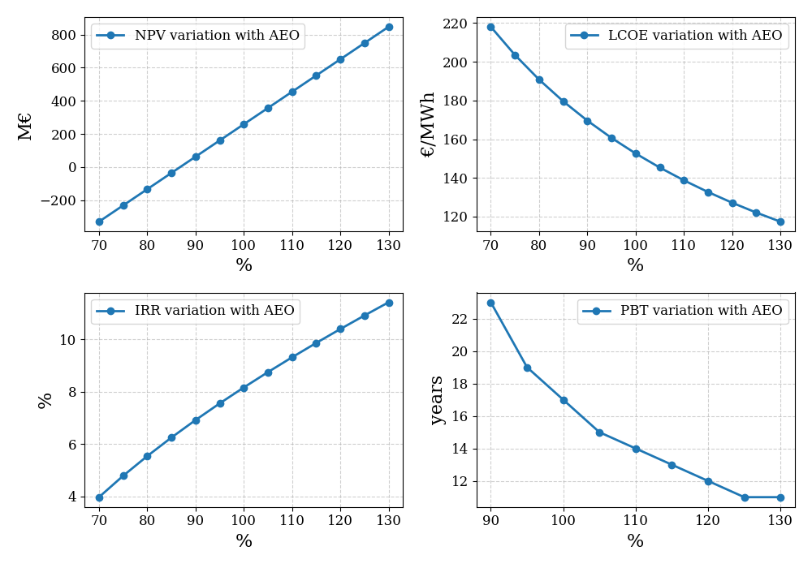
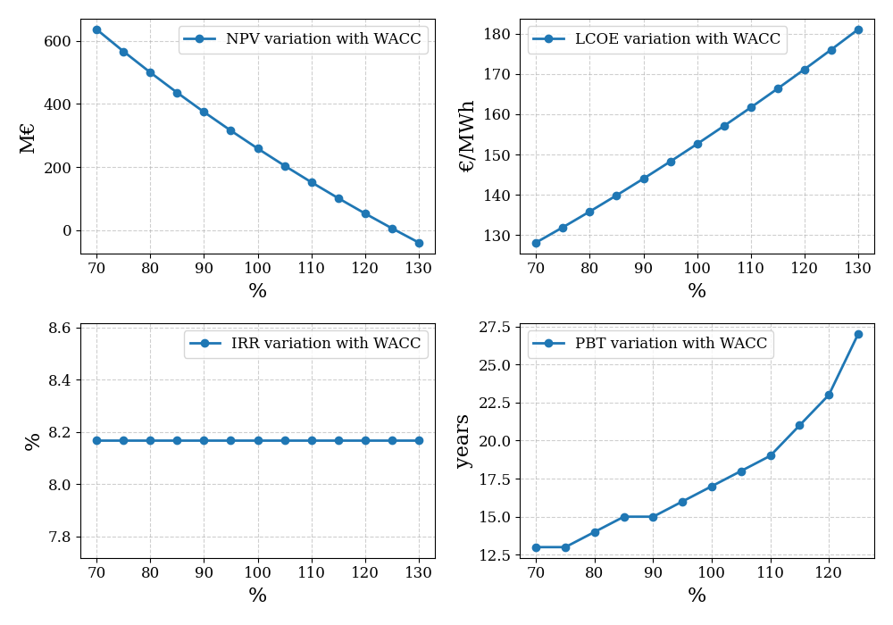
Wind Energy
HYDROGEN SCENARIO
SENSITIVITY ANALYSIS
NO FIP SCENARIOS
Sensitivity Analysis
Performed with respect to Upgrade Scenario.
Range of variation from 0,7 to 1,3 of nominal values.
Politecnico di Milano

Slide 21

Wind Energy
HYDROGEN SCENARIO
SENSITIVITY ANALYSIS
NO FIP SCENARIOS
Hydrogen Scenario
No incentives → No plant profitability
What if we include the possibility to produce hydrogen when it is convenient?
YES
Sell electricity
For each hour of the year
Electricity From Wind Farm
$$C_{DAM }>C_{H2}$$
NO
Produce and sell H2
Politecnico di Milano

Slide 22
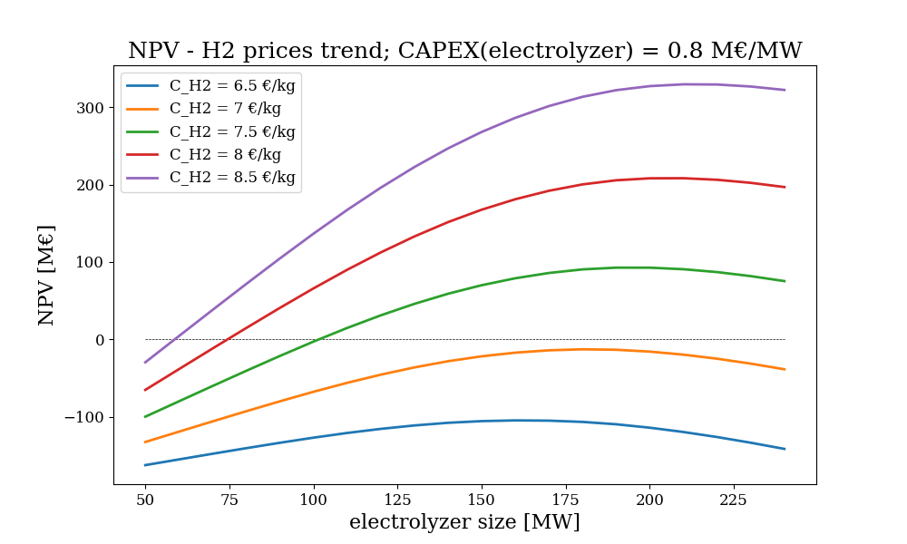
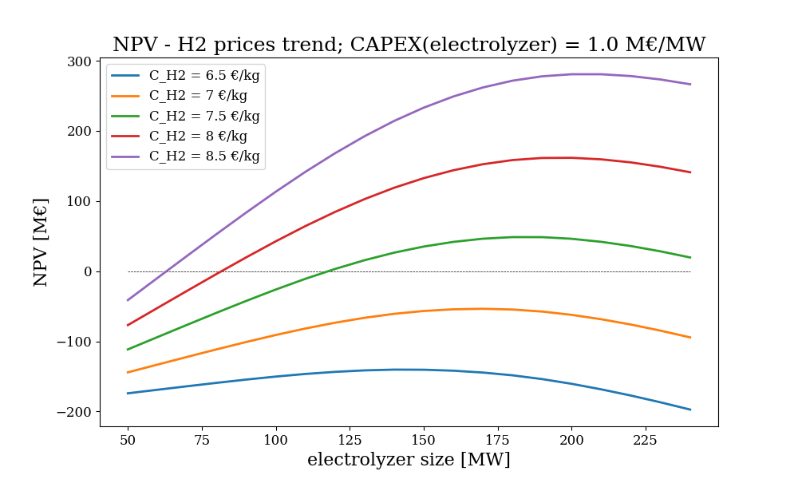
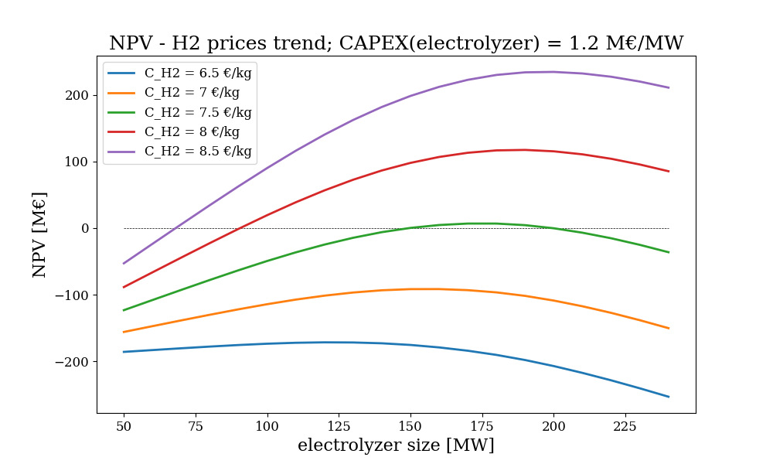
Wind Energy
HYDROGEN SCENARIO
SENSITIVITY ANALYSIS
NO FIP SCENARIOS
Hydrogen Scenario
Politecnico di Milano

Slide 23
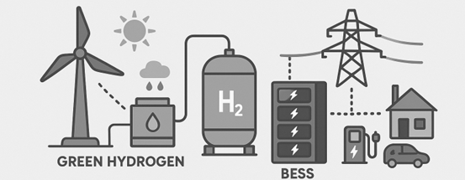
Wind Energy
Conclusions
If incentives are given the plant is overall economically profitable.
In order to get incentives is important to build the plant in less than 60 months.
In case of no incentives, some changes to the project are needed, like the possibility of producing and selling hydrogen, which will allow to recover part of the investments. Another possibility could be the adoption of BESS technology but only if the plant is participating to capacity market.
Politecnico di Milano

